Slide 1
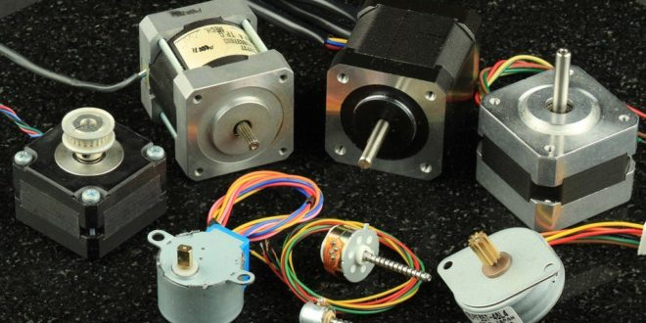
Stepper Motor Basics

Slide 2
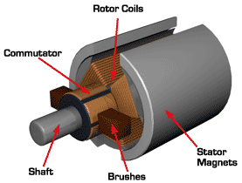
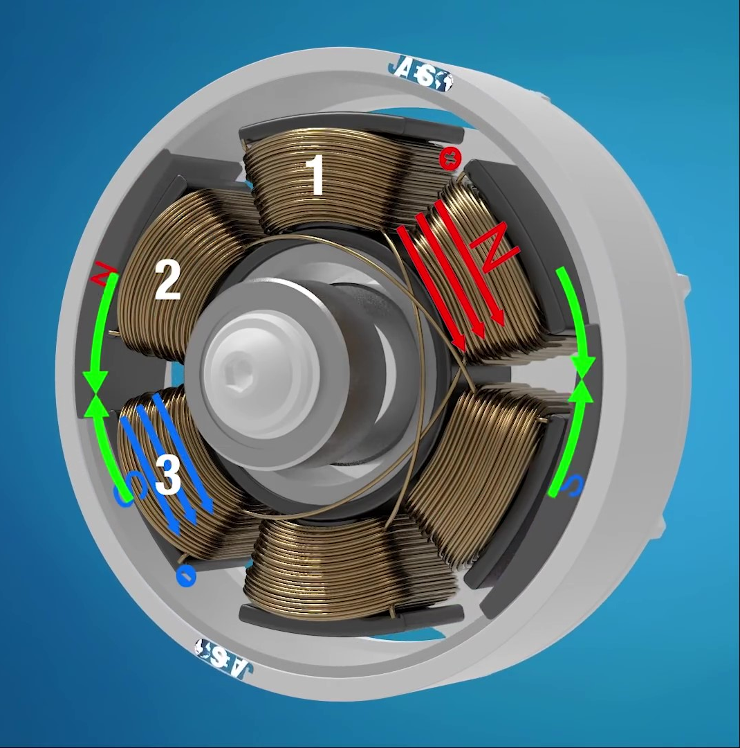
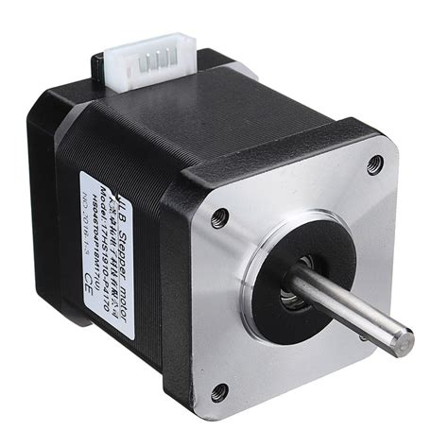
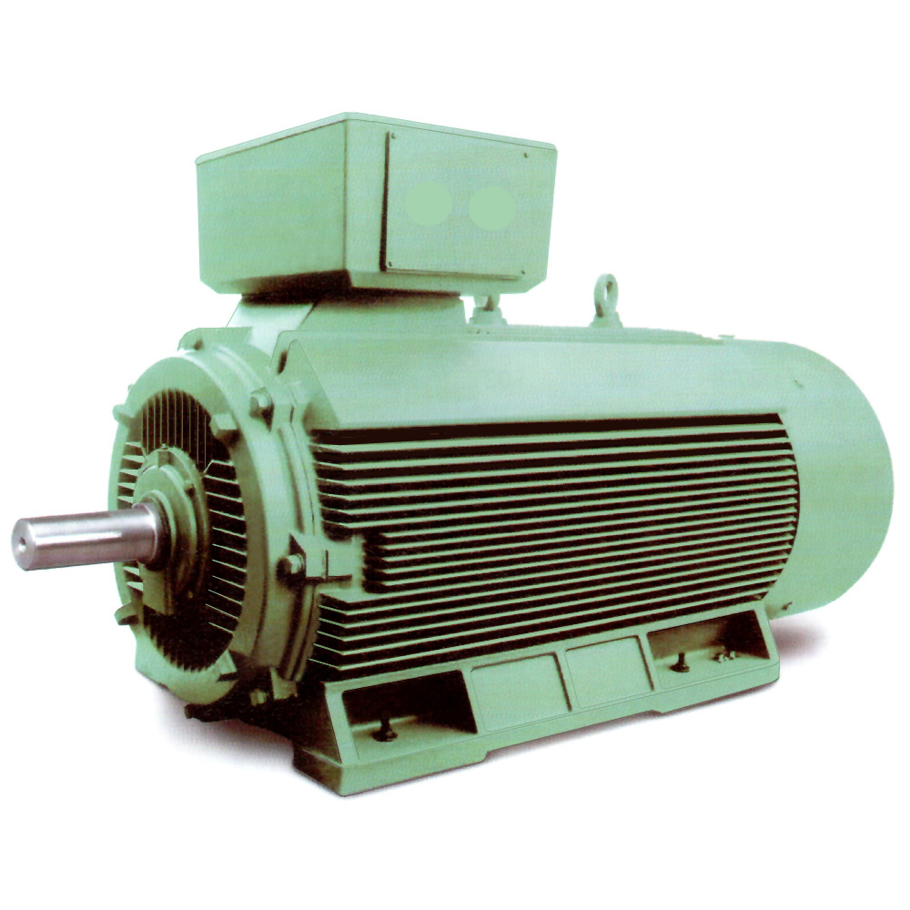
Common Motor Types
DC Motors
AC Motors
Other Motors
Brushless
Stepper
Watch Video Here

Slide 3
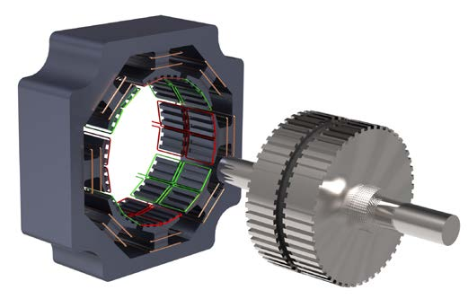
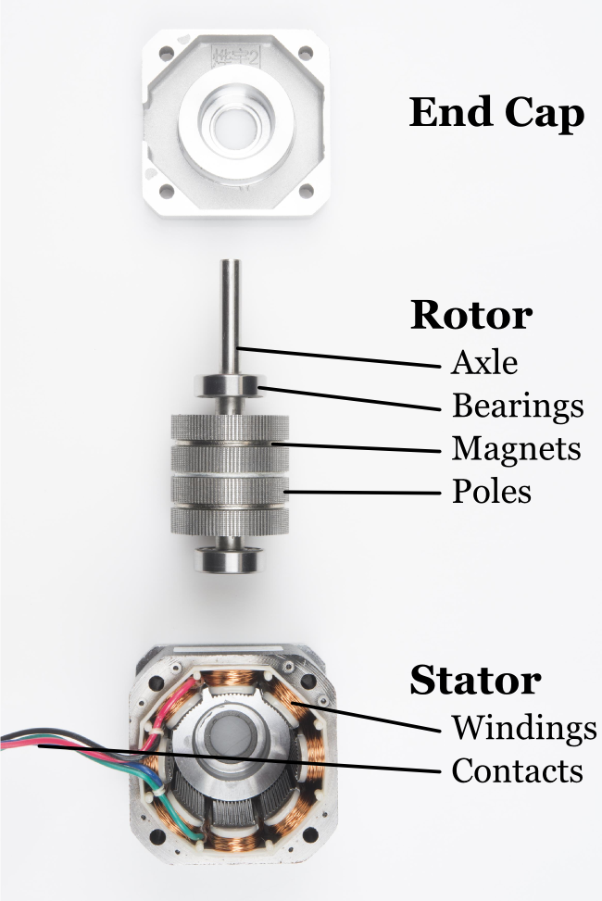
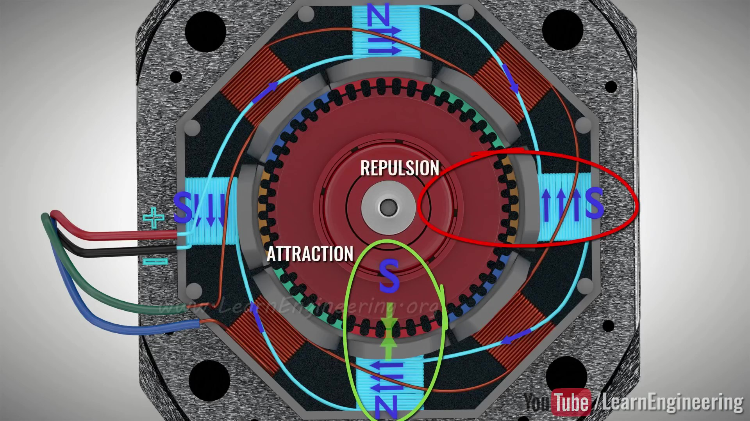
Stepper Motor Anatomy
Watch Video Here

Slide 4
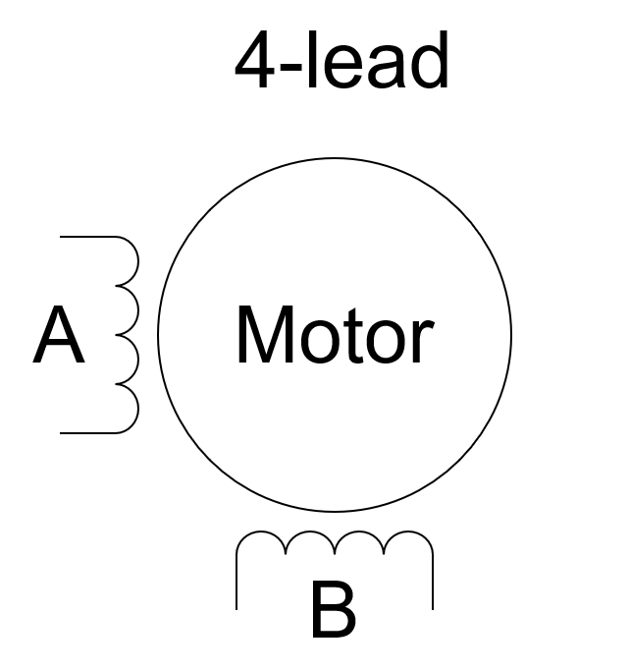
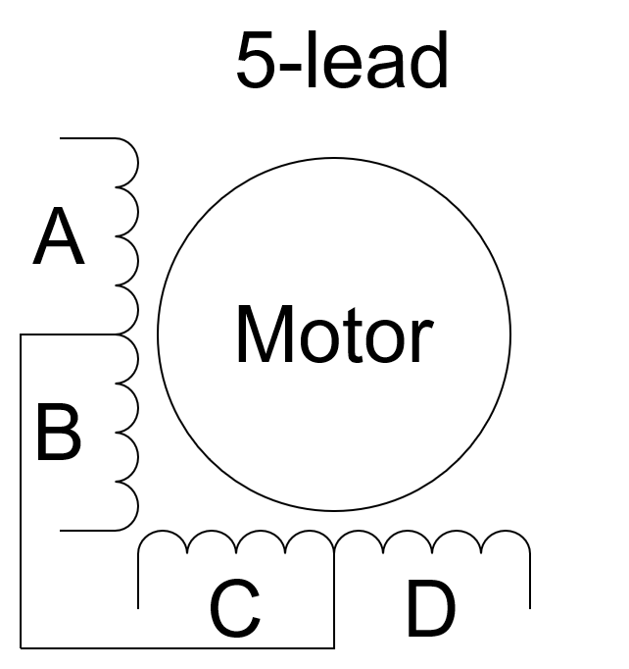


Stepper Motor Wiring
Unipolar (5, 6, 8-lead)
2 windings per phase
Simpler to drive/control
Current does not need to be reverse
Bipolar (4-lead)
1 winding per phase
More complex to drive/control
Current must be reverse

Slide 5
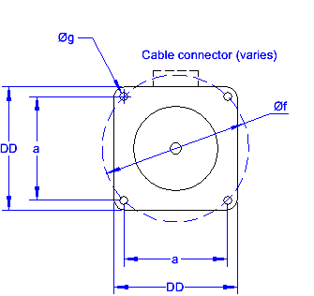
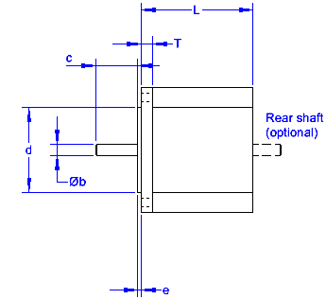
NEMA Motor Dimensions
Motor | DD (mm) | a (mm) | b (mm) | c* (mm) | d (mm) | e* (mm) | f (mm) | g (mm)
NEMA 8 | 20.3 | 16 | 4 |  | 15 | 1.5 | 22.6 | 3
NEMA 11 | 27.9 | 23 | 5 |  | 22 | 2 | 32.5 | 4
NEMA 14 | 35.6 | 26 | 5 |  | 22 | 2 | 36.8 | 4
NEMA 17 | 43.2 | 31 | 5 | 24 | 22 | 2 | 43.8 | 4-40 UNC
NEMA 23 | 58.4 | 47.1 | 6.35 | 20.6 | 38.1 | 1.6 | 66.7 | 5
NEMA 34 | 86.4 | 69.7 | 9.5 | 31.8 | 73 | 1.6 | 98.4 | 5.5
NEMA 42 | 106.7 | 88.9 | 16 | 35.1 | 55.5 | 1.6 | 125.7 | 7.1
*max length
Source

Slide 6
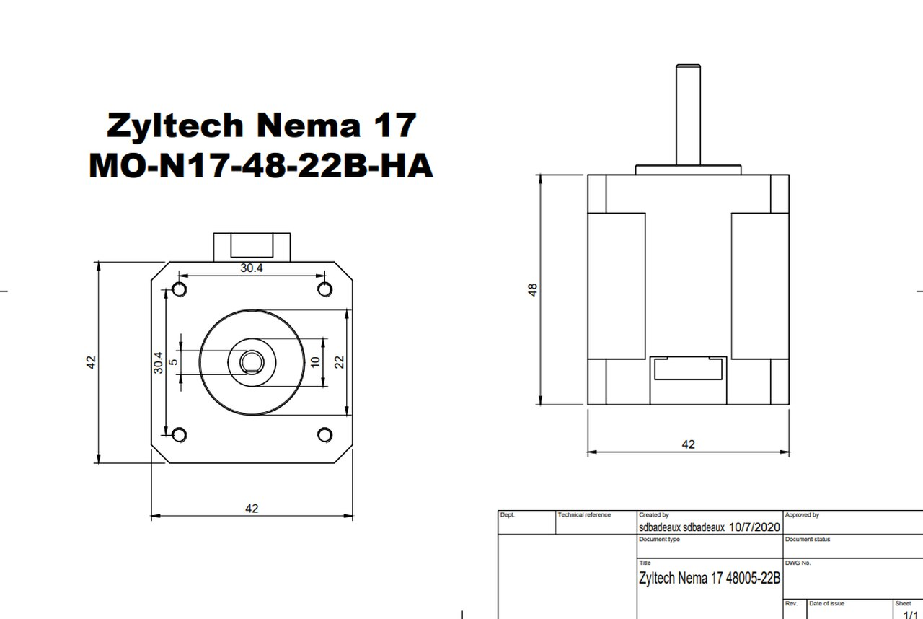
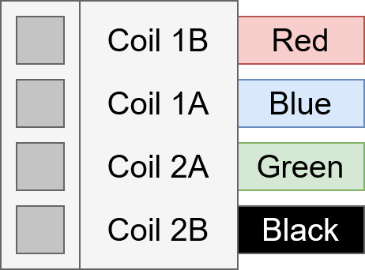
Your NEMA 17
Bipolar, 4-lead
1.8° Step Angle
1.7 A current max
0.59 Nm holding torque
Vender

Slide 7
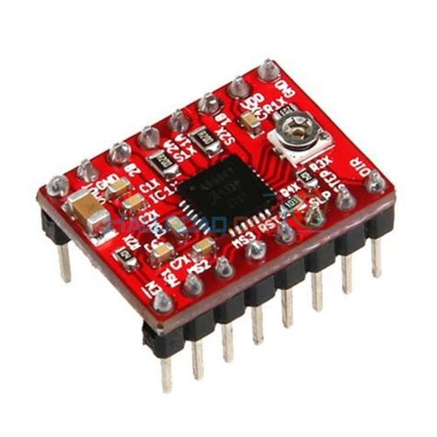
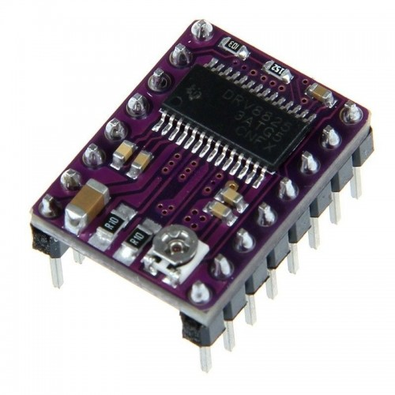
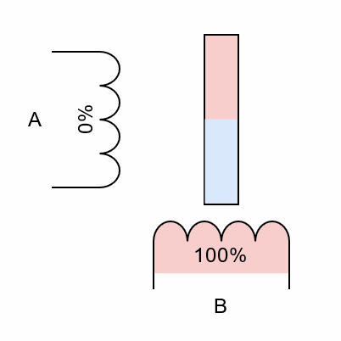
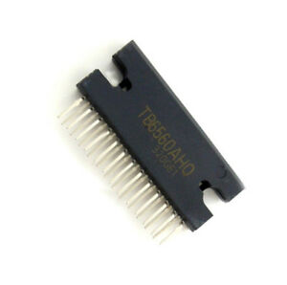
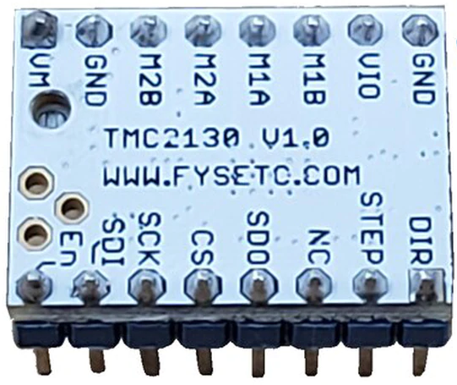
Stepper Motor Control
Common Controllers
A4988
DRV8825
TB6560AHQ
TMC2130
Microstepping
A4988 – 16th stepping
DRV8825 – 32nd stepping
TB6560AHQ – 16th stepping
TMC2130 – 256th stepping
Interesting article about microstepping accuracy

Slide 8
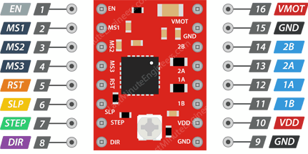
Your Stepper Motor Driver (A4988)
Pin 1 – Enable pin, Low is enabled
Pin 2 – Microstep selection pin 1
Pin 3 – Microstep selection pin 2
Pin 4 – Microstep selection pin 3
Pin 5 – Reset pin, Low resets
Pin 6 – Sleep pin, Low puts to sleep
Pin 7 – Step control pin
Pin 8 – Direction control pin, Low is CCW
MS1 | MS2 | MS3 | Microstep Resolution
Low | Low | Low | Full step
High | Low | Low | Half step
Low | High | Low | Quarter step
High | High | Low | Eighth step
High | High | High | Sixteenth step
Source
Vender

Slide 9
Your Stepper Motor Driver (A4988)
Pin 9 – Ground
Pin 10 – Logic voltage supply, 5V
Pin 11 – Bipolar motor pin, coil 1B
Pin 12 – Bipolar motor pin, coil 1A
Pin 13 – Bipolar motor pin, coil 2A
Pin 14 – Bipolar motor pin, coil 2B
Pin 15 – Ground
Pin 16 – Motor voltage supply, 12V
35V and 2A maximum rating
Source
Vender

Slide 10
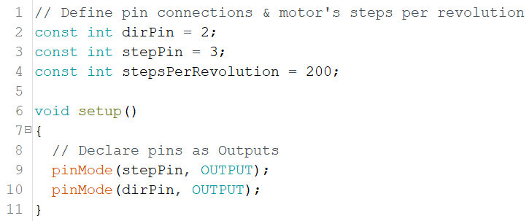
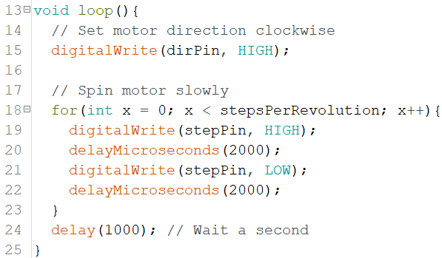
Arduino Code
Source

Slide 11
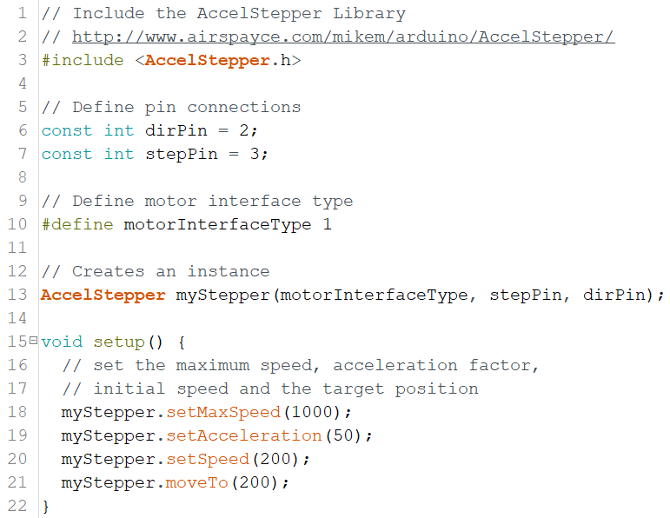
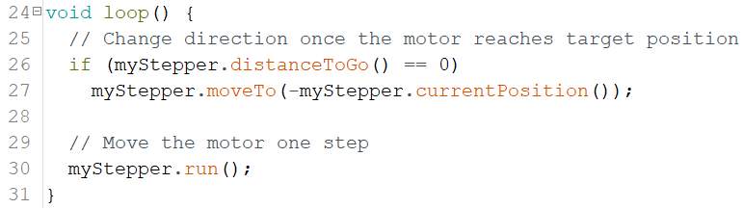
Arduino Code using AccelStepper
Source
To install AccelStepper, go to Sketch > Include Library > Manage Libraries … and search for AccelStepper then select Install.

